Slide 1
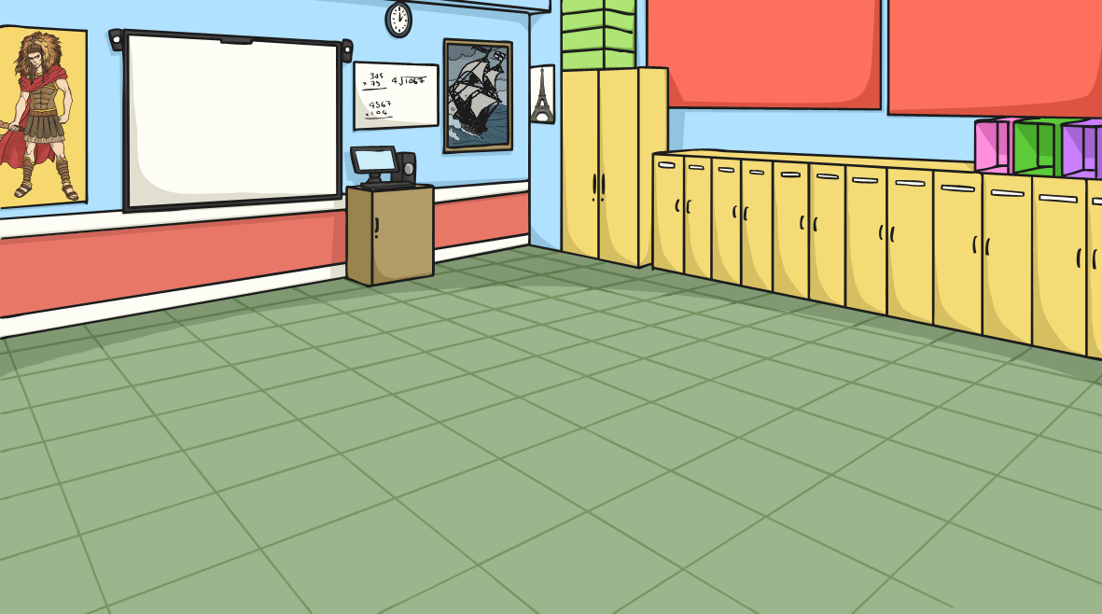
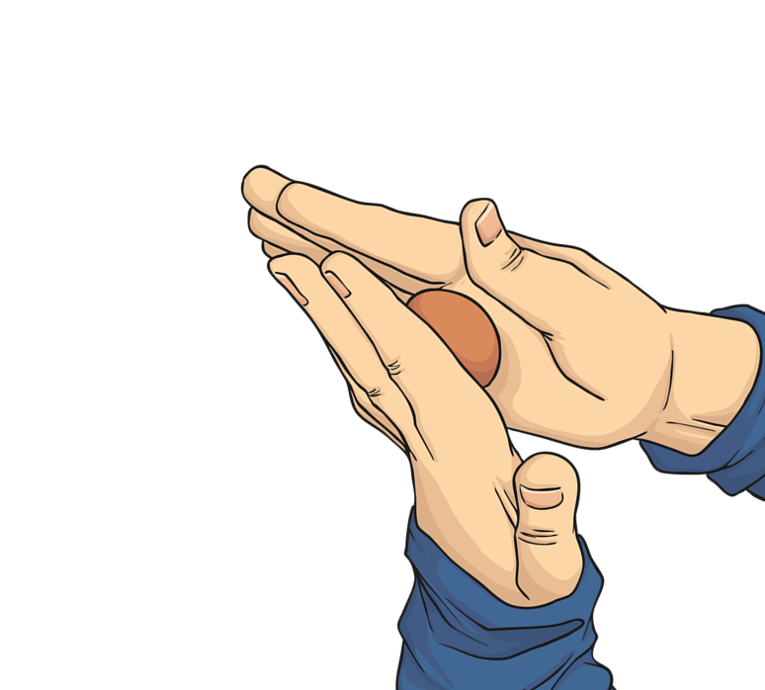
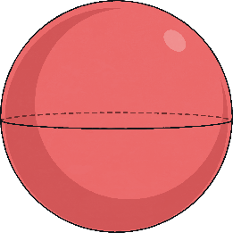
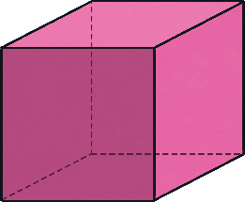
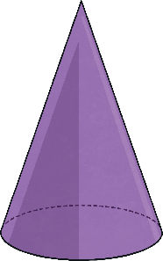
Streamlined Shapes
Try this mini-investigation to explore streamlined shapes.
Weigh out three equal pieces of modelling clay.
Then mould each piece into one of the three different shapes shown below.
sphere
cube
cone

Slide 2
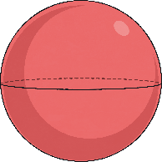
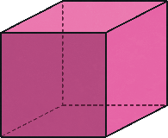
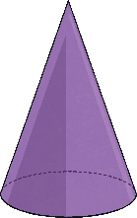
Streamlined Shapes
Which shape do you think will fall the fastest? Which will fall the slowest?
Try it out!
You will drop each shape into the water and use a stopwatch to time how long it takes to fall through the water.
Fill three identical measuring cylinders with the same amount of water.

Slide 3
Streamlined Shapes
Can you give an example of an animal that has a streamlined shape?
The cube should have fallen the slowest through the water. It is the least streamlined shape because it has a flat surface which creates a lot of water resistance. The water pushes against the flat surface, slowing it down.
The cone should have fallen the fastest through the water. It is the most streamlined shape as it has a pointed end to cut through the water.

