Slide 1
Year 6
Parent Information Evening
Thursday 7th November 2019

Slide 2
Overview of the evening
Year 6 expectations
Changes
SATs
Robinwood
Transition to Secondary School

Slide 3
Year 6 expectations
Homework
Set on a Friday, due on a Wednesday.
Revision tool covering Maths, Writing, Reading and SPaG.
If homework is not completed, the expectation is that the child will complete it in their own time.

Slide 4
Year 6 expectations
Home reading
3 x a week, recorded in their home reading record.
To build reading stamina, introduction to new vocabulary and develop comprehension skills.
Evidence connecting good readers and good writers.
If home reading is not completed, the children will be given the opportunity to read in their own time.

Slide 5
Year 6 expectations
Uniform
White or sky blue polo shirt.
Black / grey trousers /skirt or blue and white checked school dress.
Black / white socks or black tights.
Black shoes - not trainers or high heels (boots can be worn for outside but shoes /pumps worn in school. Trainers can be worn only for break times and PE.
Navy blue sweatshirt /cardigan.
In this, we are reflecting the policies of local Secondary Schools.

Slide 6
Year 6 expectations
Behaviour
High expectations of behaviour.
Setting the standard, acting as role models to the rest of the school.
Children will be praised / rewarded for behaviour that is in line with our expectations.
They will also be taught that there are consequences for their actions. This will prepare them for Secondary School and later life.
Respectful, courteous, kind and trying their best.

Slide 7
Year 6 expectations
Attendance
It is important that pupils attend school regularly.
Due to the depth of learning in Year 6, any absences will result in your child missing key aspects of the curriculum.
If there are issues, please come and speak to a member of the Year 6 team.

Slide 8
Changes
All children have a puberty talk in Year 6 which tops up the introduction given to them from the puberty talk in Year 5.
Female nurse and female member of staff for girls: they will talk about the changes that happen to girls and how body parts develop. The nurse will also look at personal hygiene.
Male member of staff for boys: using the NHS guidance they will talk about the changes that happen to boys and girls and how boys’ body parts develop. We will also look at personal hygiene.
The children will also have support to deal with their emotions during their time in Year 6 – we will support them with worries about SATs and leaving primary school.
Personality changes – it is normal to see changes in your child’s personality as the year progresses. The Year 6 team are on hand to support your child through this process.

Slide 9
SATs

Slide 10
What’s new?
With the introduction of the new Primary National Curriculum in 2014, the government abolished National Curriculum levels (Level 3a, 3b, 3c, 4a, etc).
Children are now given a scaled score for their SATs. With the scaled score, there is a national age related expectation.
There are high expectations for all children to reach the expected standard.

Slide 11
What is a scaled score?
Each pupil will be given a raw mark (the number of marks they get on a test) which is then converted into a scaled score using a conversion table.
A scaled score of '100' represents the 'national standard'.
A scaled score of '100' or more means that a child is working at the national standard for a child of their age.
A scaled score of ‘110’ or more means that a child is working at greater depth against the national standard for a child of their age.

Slide 12
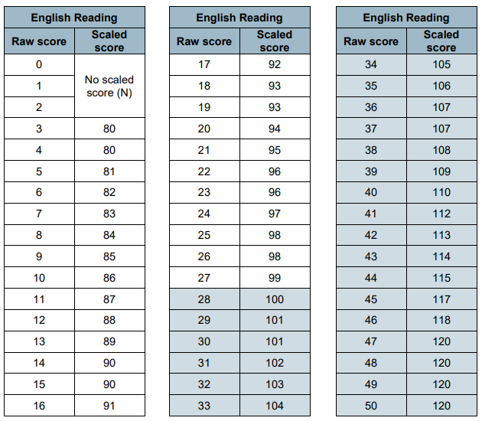
2017 scaled score conversion tables compared with 2018

Slide 14
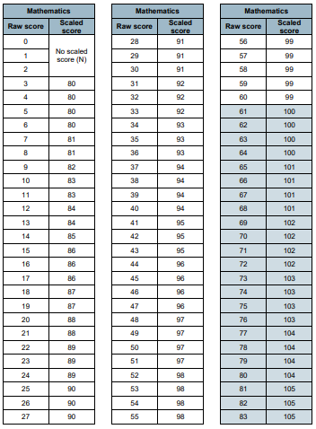
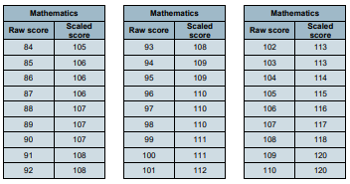

Slide 15
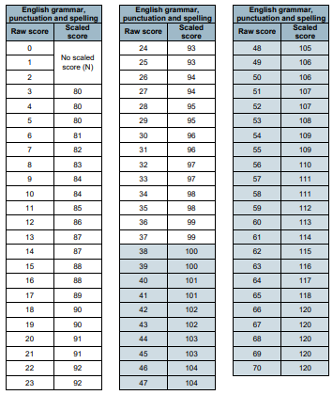

Slide 16
What does it all mean?
On publication of the test results in July 2020:
A child awarded a scaled score of 100 is judged to have met the ‘national standard’ in the area judged by the test and is said to be ‘working at the expected standard’.
A child awarded a scaled score of less than 100 is judged to have not yet met the national standard and is said to be ‘working towards the expected standard.’
A child awarded a scaled score of 110 or more is judged to have exceeded the national standard, demonstrating a higher than expected knowledge of the curriculum for their age, and is said to be ‘working at greater depth against the expected standard.’

Slide 17
SATs week 2020
Date | Activity
Monday 11 May | English grammar, punctuation and spelling paper 1 English grammar, punctuation and spelling paper 2
Tuesday 12 May | English reading
Wednesday 13 May | Mathematics paper 1 Mathematics paper 2
Thursday 14 May | Mathematics paper 3
Please ensure there are no absences
during this week.

Slide 18
Spelling, Grammar and
Punctuation
15 minute Spelling test based upon words learnt throughout Key Stage 2.
45 minute spelling, punctuation and grammar test involving short answer or simple explanation questions.
Marks from both test are added together. The spelling test alone is worth 20 marks.

Slide 20
Reading
60 minutes.
3 unrelated texts and 1 answer booklet.
The questions are designed to assess the understanding of a child's reading through a variety of comprehension questions. Questions test children’s ability to retrieve and infer, to summarise and predict and their understanding of the author’s language choices.
The wording of the questions can be confusing.
Some questions are multiple choice or selected response, others require short answers and some require an extended response or explanation.

Slide 23
Mathematics
The children will sit three tests (Paper 1, 2 and 3).
Paper 1 (Arithmetic) 30 minutes. 36 questions that test calculation methods for all operations (+ - x ÷), including fractions, percentages and decimals. This alone is worth 40 marks.
Questions increase in difficulty as the children progress through it.
Paper 2 and 3 (Reasoning and Problem Solving) 40 minutes. Tests the application of calculation methods and other areas of the maths curriculum such as shape, measure, geometry and statistics.
Pupils must read each question carefully and there may be several steps involved in order to find a final answer.

Slide 26
How will we help?
Children are organised into specific groups across the year group for reading and maths with additional teachers available for targeted support.
Spelling, punctuation and grammar is taught within English lessons and as standalone revision sessions.
Booster sessions for maths and SPaG take place in an afternoon 3 times a week.
Regular test practice.
Weekly homework.
CPG revision books available.
High expectations at all times!

Slide 27
How can you help?
First and foremost, support and reassure your child that there is nothing to worry about and that all we can ask for is them to try their best. Praise and encouragement works wonders!
Ensure your child has the best possible attendance at school.
Support your child with any homework tasks.
Regular spelling and arithmetic (e.g. times tables) practise will be useful.
Listen to your child read regularly and discuss what they are reading with them.
Talk to your child about what they have learnt at school.
Make sure your child has plenty sleep and a healthy breakfast each morning.

Slide 28
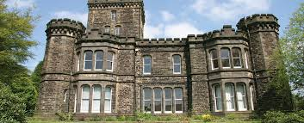
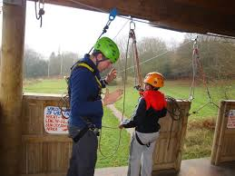
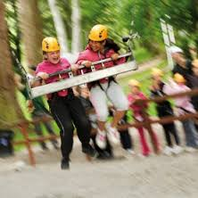
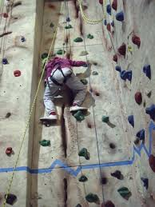
Robinwood
Wednesday 10^{h} June – Friday 12th 2019

Slide 29
Dobroyd Castle
Dobroyd Castle is set high up on the Todmorden moors enjoying some fantastic views of the surrounding area. It is a historic, grade two listed building, with wonderful architecture including a breath taking main entrance hall. The 17 acres of grounds, which accommodate Robinwood are full of adventure and teamwork activities. They are also home for a wide range of wildlife including deer, rabbits and many more.

Slide 30
What will the children be doing?
Wide variety of activities which will encourage team work and social skills.
Opportunity to try activities they have never done before and to challenge themselves.
Personal challenges.

Slide 31
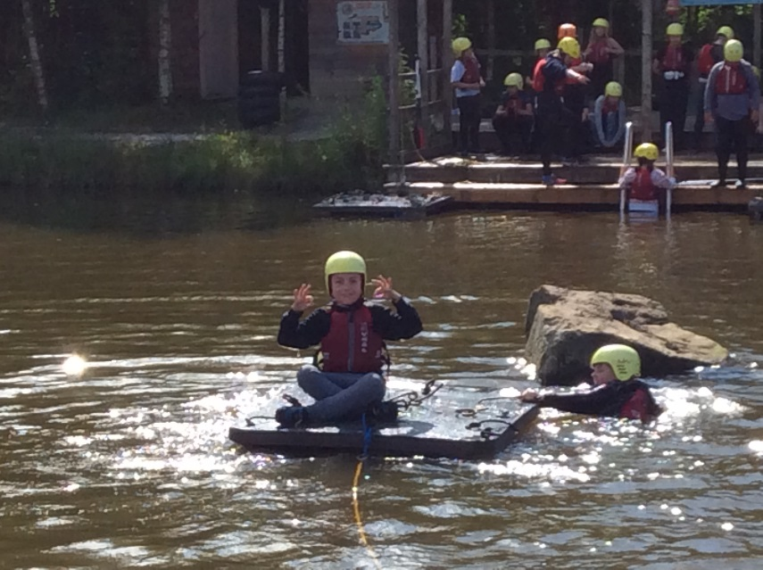
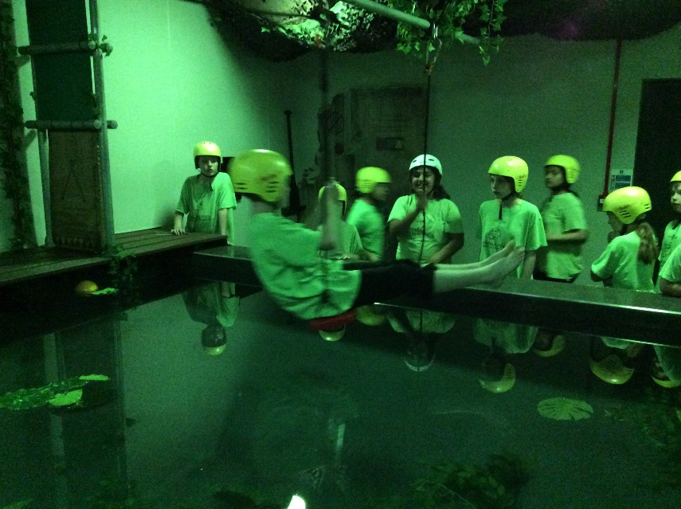
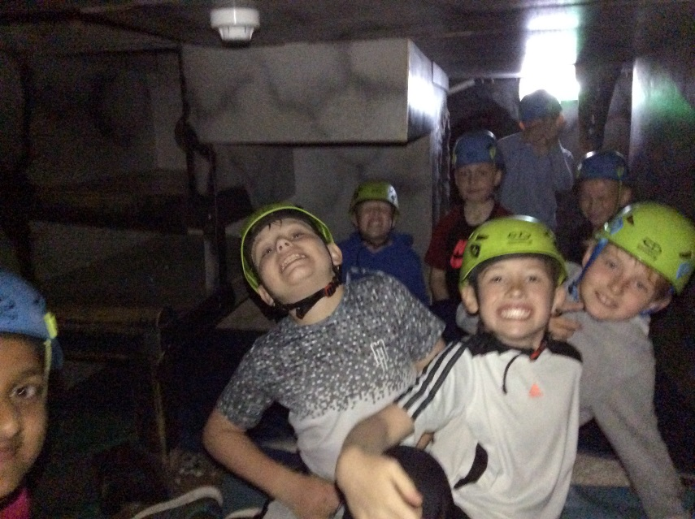
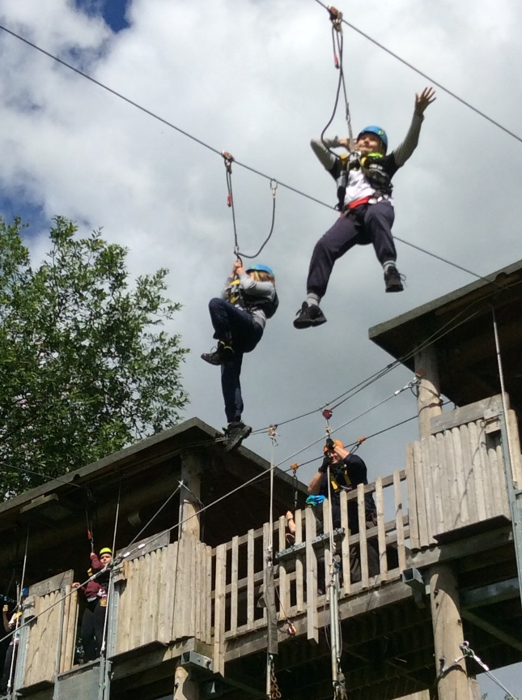
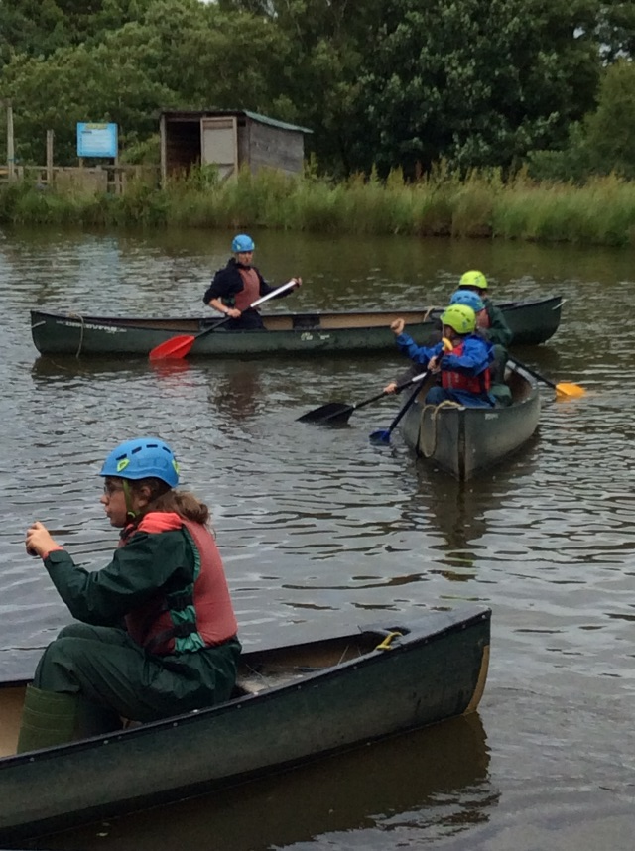
Zip wire
‘Piranha Pool’
Caving
Canoeing
Raft building

Slide 32
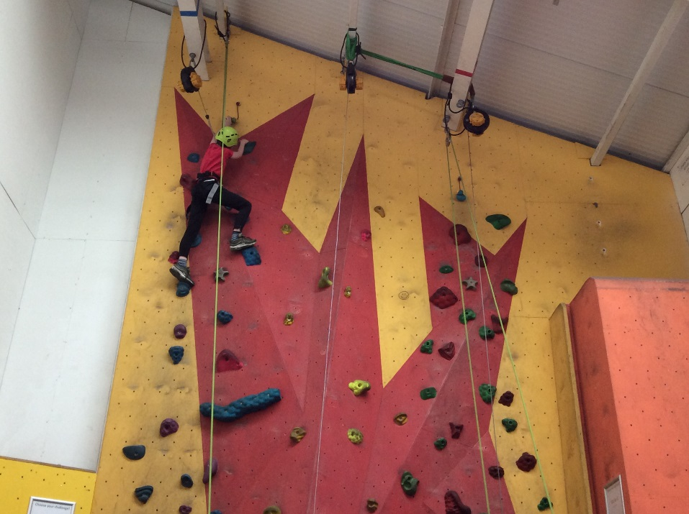
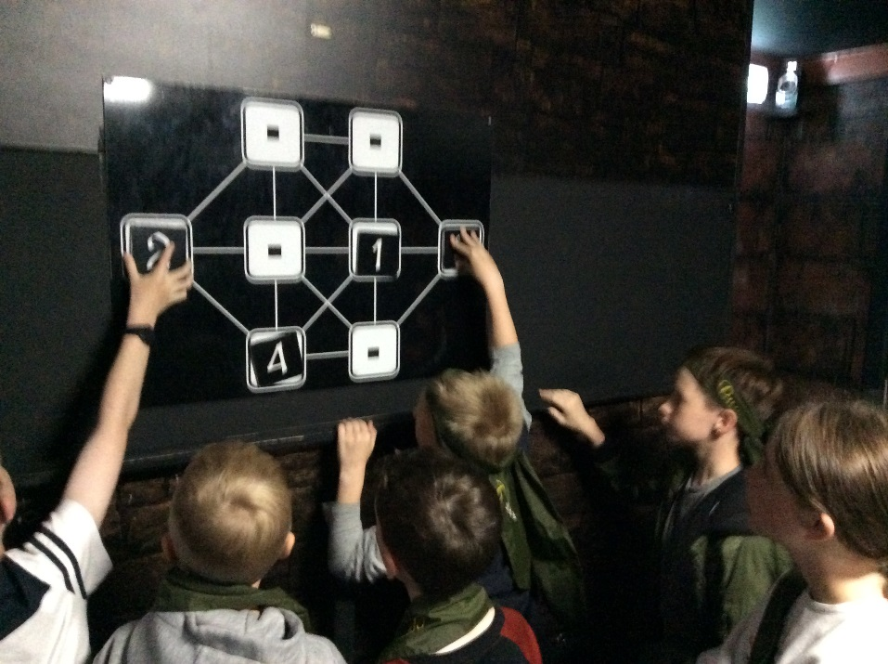
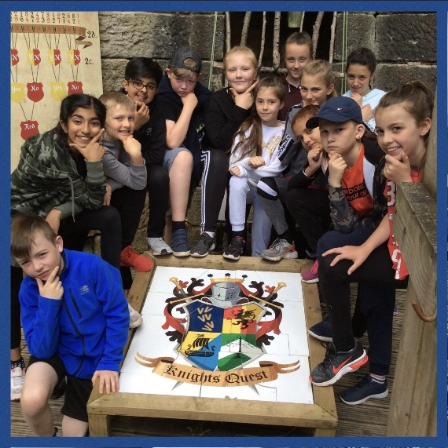
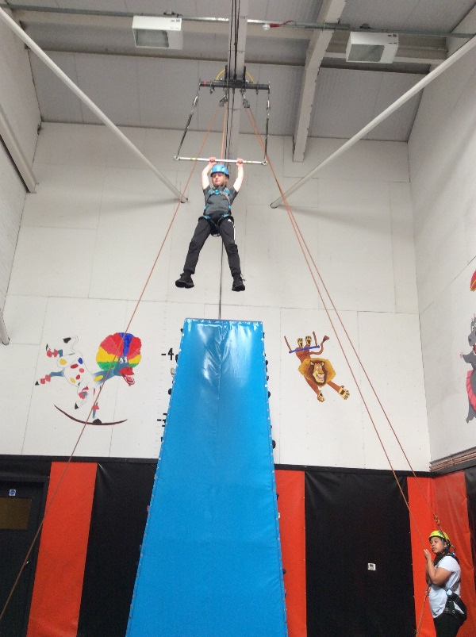
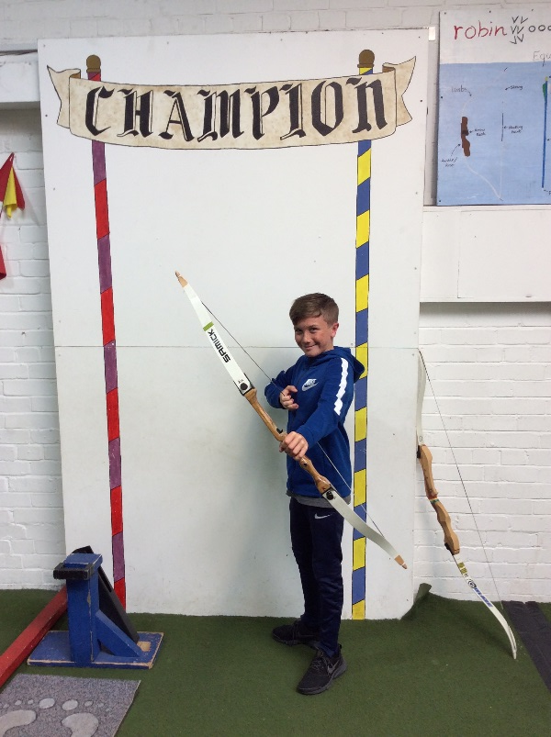
Dungeon of Doom
Climbing
Archery
Crate challenge
Knights Quest
Trapeze

Slide 33
Dobroyd Castle Staff
All activities are run by the staff at Dobroyd Castle.
They are all fully qualified in delivering the activities in as safe a way as possible.
Risk Assessments are carried out by school staff as well as site staff.
All Robin Wood staff are first aid trained.

Slide 34
Robin Wood Will Provide:
There is no need to go out and buy anything special for a trip to Robinwood, all specialist equipment is provided. The children will need:
heavy duty waterproof cagoules,
heavy duty waterproof over trousers,
warm fibre pile tops,
warm fibre pile mittens,
heavy duty wellies,
footwear for water-sports activities,
full sets of clothing for the piranha pool
additional towels

Slide 35
Transition to Secondary
School
Growing up is hard to do – friendships and relationships
Who is there to help?
When and how does transition happen?

Slide 36
Growing up
Transition to secondary school can be a worrying time for children:
They are moving away from their safety net at Primary School
They may be moving to a school different to all of their friends
Secondary schools are much bigger
Children will have a different teacher for each subject
Children are required to become more independent.
Don’t worry - most children cope with these and feel accustomed to the changes by the end of the first couple of weeks.

Slide 37
When and how does transition happen?
On Friday 1st March families will find out which secondary school their child has been offered a place at – you will need to accept this or appeal if unhappy with the allocation offer.
Once the children have taken their SATs in May, members of staff from secondary schools will begin to come to Blakehill to meet the children prior to their transition day.
Wednesday 1st July all children attending secondary schools in Bradford have their transition day.
Children who we feel need extra support during transition will have additional sessions at their school before and after this date.

Slide 38
Who is there to help?
Within school, Mrs Armitage and Mrs Feather co-ordinates the transition process; liaising with schools and supporting children.
Both Mrs Feather and Mrs Armitage will attend the extra transition sessions with children.
Secondary schools will run a parents evening around the time of transition where key information will be shared.
During our curriculum time after the SATs, we will ensure time is dedicated to preparing the children for their transition to secondary school.

Slide 39
Thank you for listening.
Questions?

