Slide 2
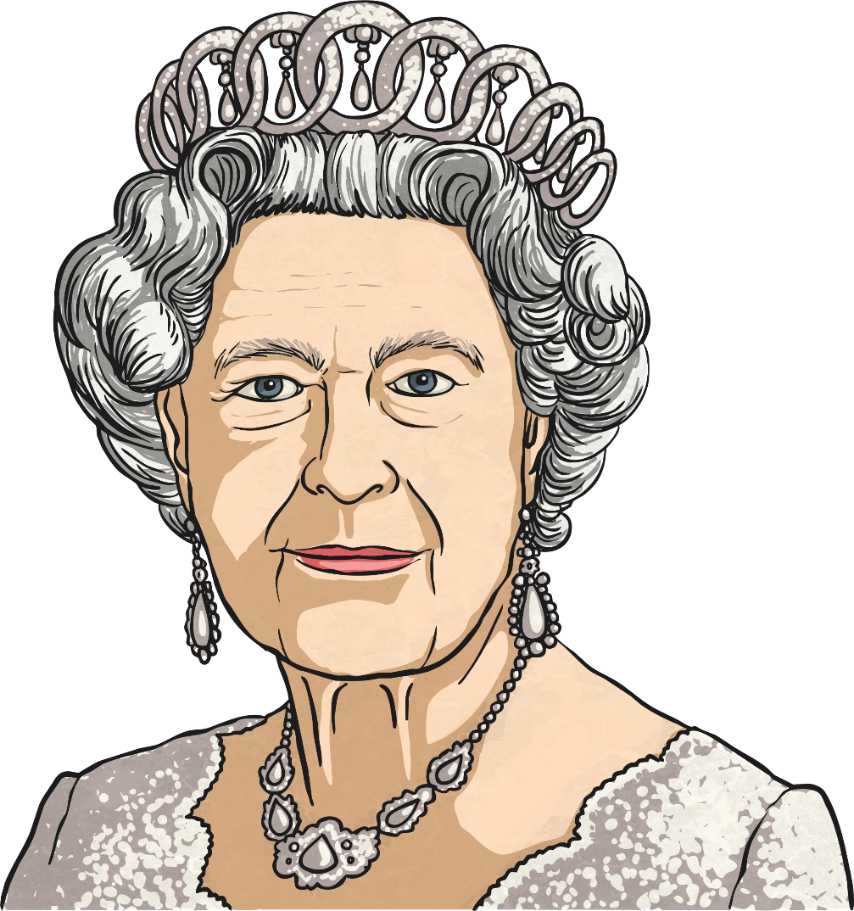
A Formal Birthday Letter to Queen Elizabeth II
Queen Elizabeth II is one of the most important figures in the World.
She has reigned over the United
Kingdom for almost 65 years and it’s time to celebrate her birthday!

Slide 3
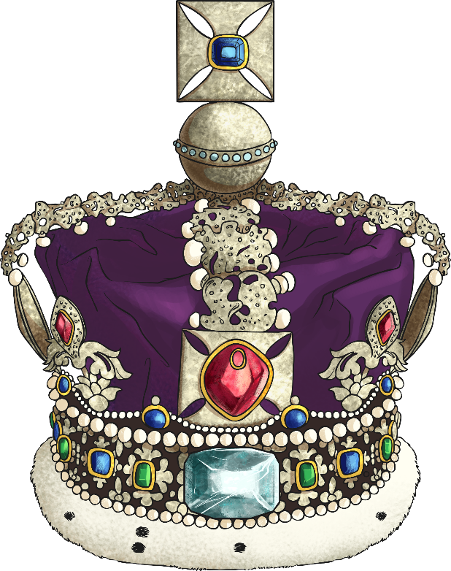
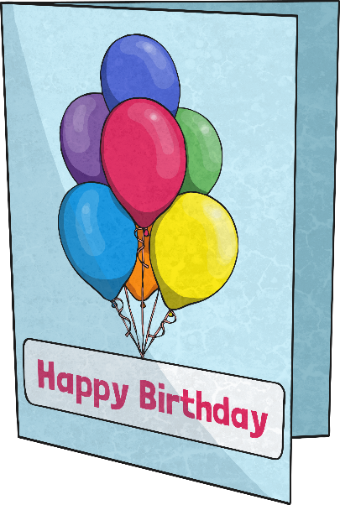
The Queen’s Birthday
Unlike most people, The Queen doesn’t just celebrate her birthday once a year. The Royal Family, and people from all around the World, actually commemorate Her Majesty’s birthday on two different dates.
Her ‘official’ birthday is on the second Saturday in June, which this year falls on 11th June.
Her actual birthday is on 21st April.

Slide 4
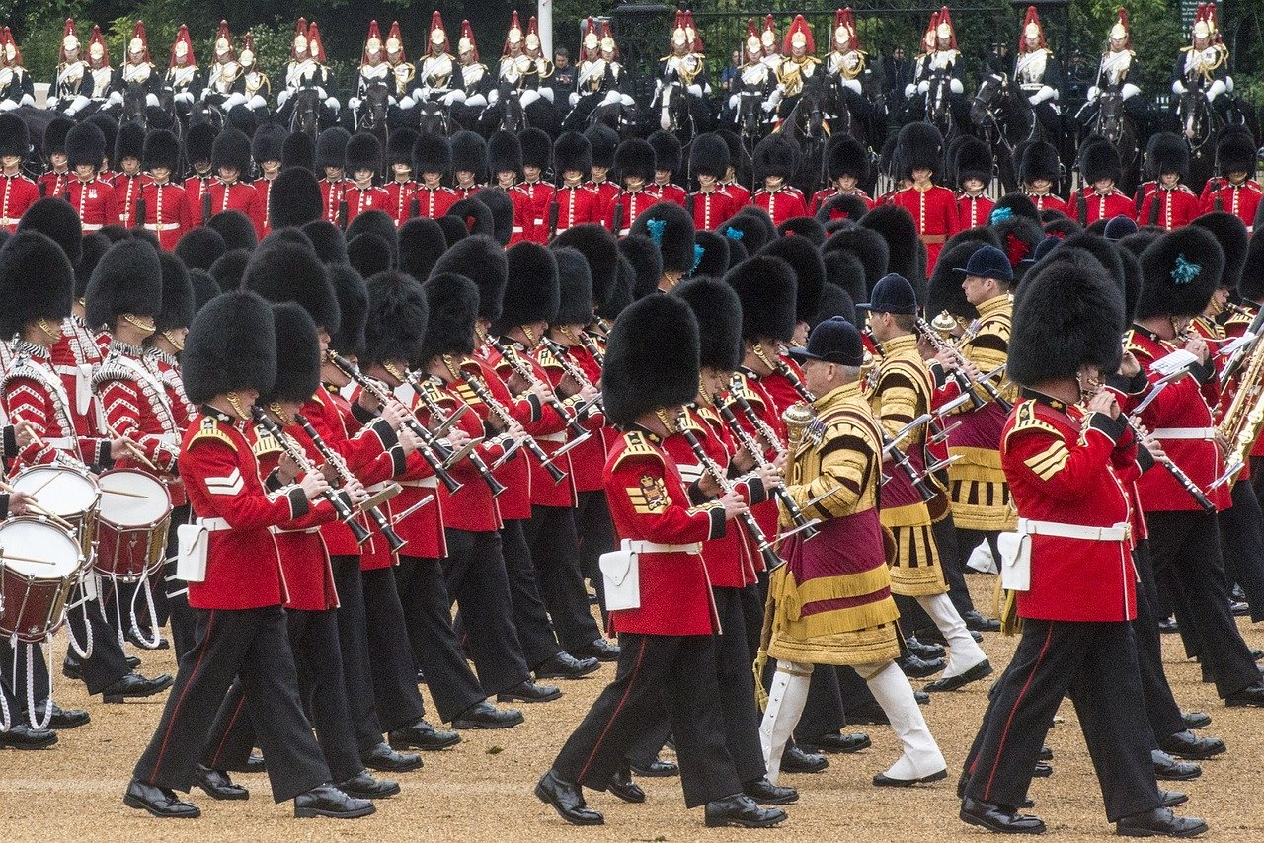
Trooping the Colour
The Queen’s official birthday is always commemorated by a special annual ceremony in London called ‘Trooping the Colour’ (pictured below).
The ceremony of Trooping the Colour is always full of military pomp and pageantry. Firstly, The Queen carries out an inspection of her troops before leading them down the Mall to Buckingham Palace, which is always full of animated and excited bystanders.
Military guns are then fired in Green Park and at the Tower of London. Finally, The Queen joins other members of the Royal Family on the balcony to watch a flypast by RAF jets.

Slide 5
Celebrating The Queen’s Birthday
Will you celebrate Her Majesty’s actual birthday this year?
What will you do?
OR Are you planning on celebrating on Saturday 11th June for Queen Elizabeth II’s official birthday?
Don’t forget to watch the Trooping The Colour ceremony.
Either way, it is not too late to send your own special birthday message to The Queen.

Slide 6
A Birthday Letter to The Queen
Why don’t you write a letter to The Queen to send her your best wishes on her birthday?
When you are writing to The Queen, you must always write in a formal style and follow certain rules of
letter-writing etiquette.

Slide 7
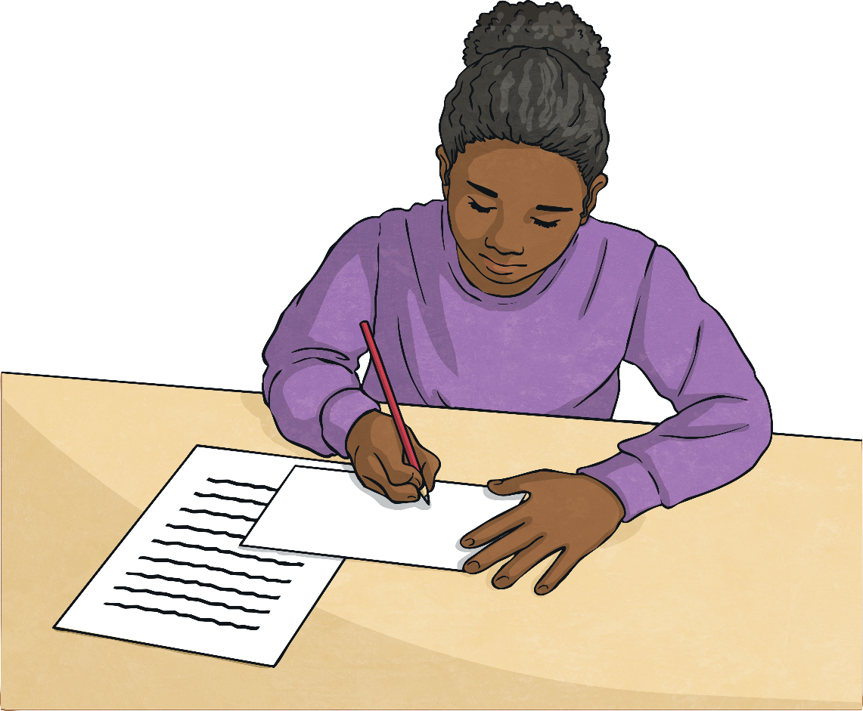
Rule 1
As The Queen receives so much correspondence each year from all over the globe, she is unable to open it all herself. Instead, she employs a ‘Private Secretary’ to deal with her incoming and outgoing mail.
For this reason, your envelope and the left-hand side of your letter needs to be addressed carefully to:
The Private Secretary to Her Majesty The Queen, Buckingham Palace, London,
SW1A 1AA

Slide 8
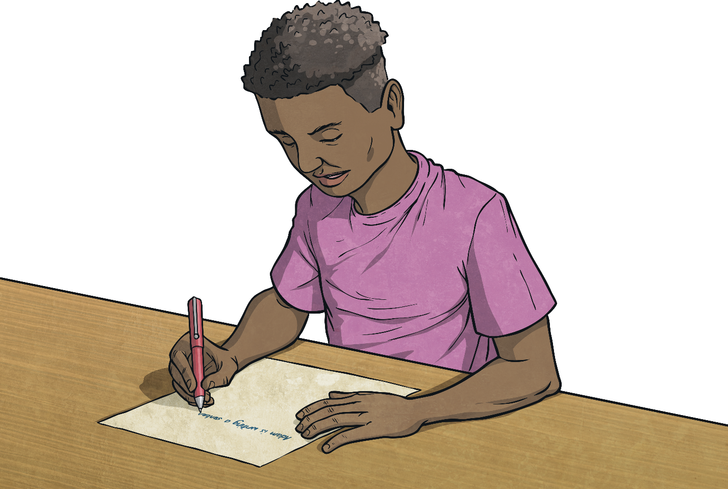
Rule 2
To open the letter you must use:
Dear Sir,
(This is because you will actually be addressing The Queen’s Private Secretary, who will be the first person to read your letter.)
And to close your letter you should use the term:
Yours faithfully,

Slide 9
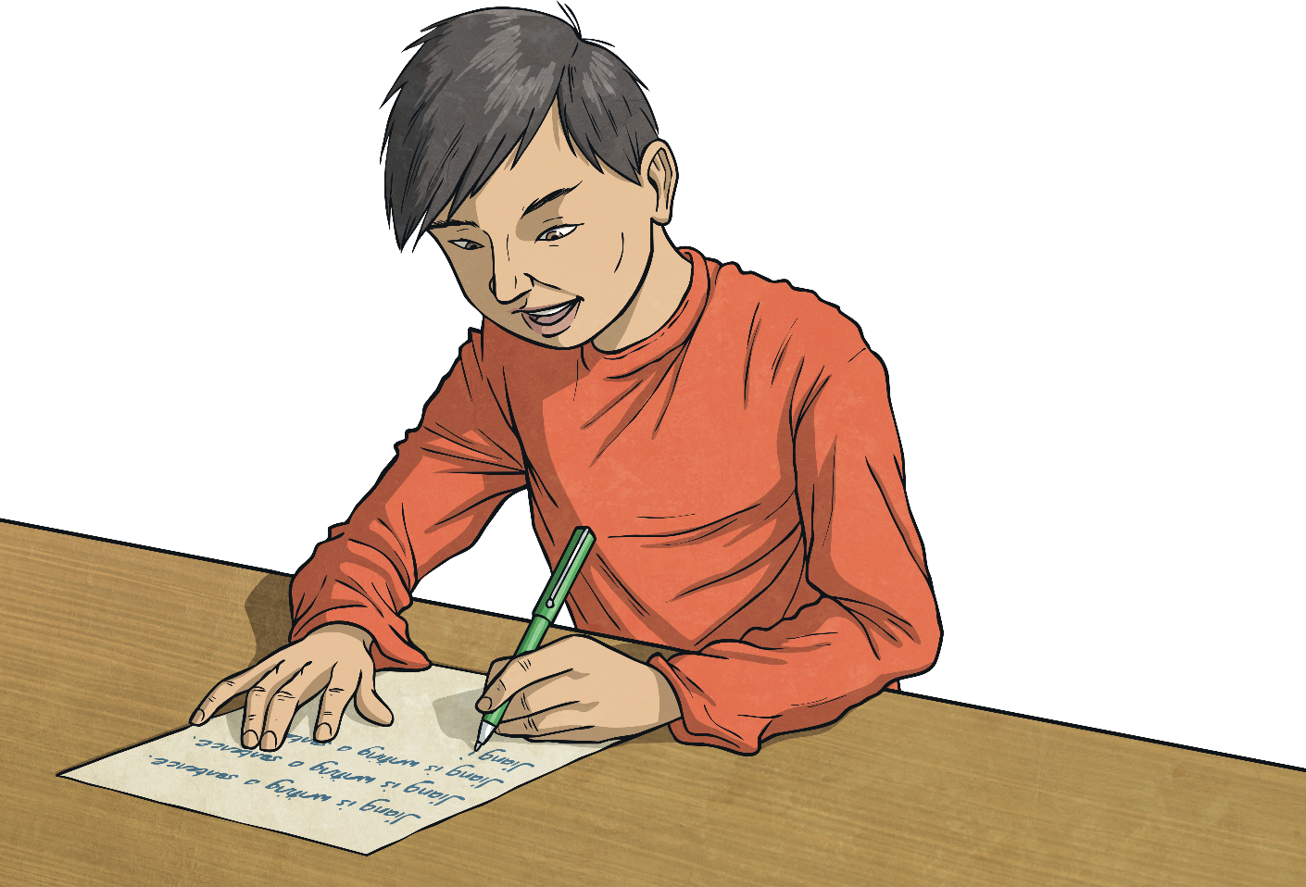
Rule 3
The first time you mention The Queen in your letter, you must use her full title:
Her Majesty The Queen
After the first mention, you should use the term:
The Queen
(Note the capitals letters used for ‘The and ‘Queen’)

Slide 10
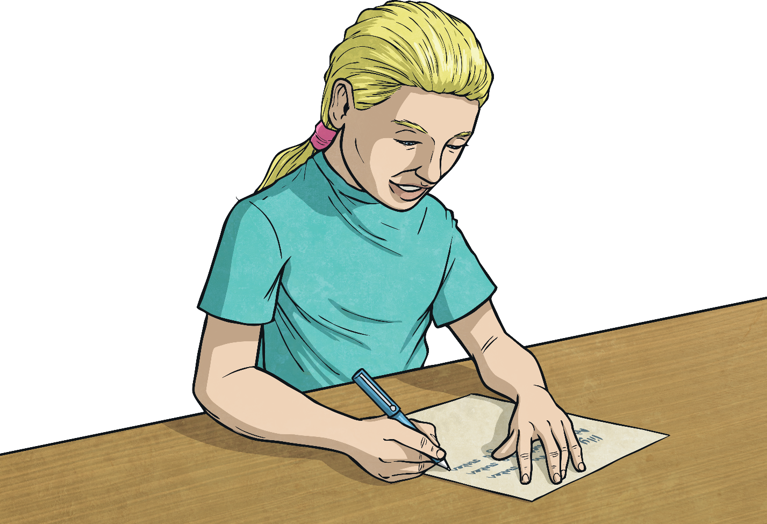
Rule 4
You must NEVER refer to The Queen as ‘she’; instead use:
Her Majesty
e.g. I think Her Majesty is an extraordinary role model for our country.
If you need to use the word ‘her’ then instead you use:
Her Majesty’s
e.g. I plan to commemorate Her Majesty’s birthday with a special celebration with my family.

Slide 11
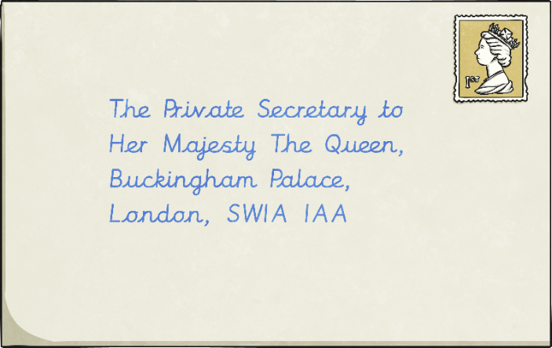
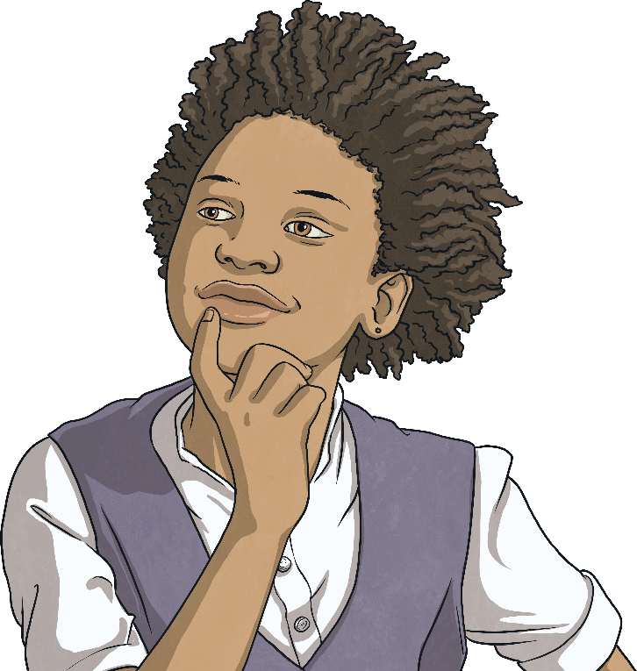
Rule 5
Try and make you letter stand out!
Although it needs to be formal in its language, you can still make your letter interesting and personal.
Her Majesty doesn't usually give personal responses. Most likely, you will receive a response written by the Private Secretary. However, The Queen does get to read a selected few, and of those, she will write back personally to some of them.
What can you do to make your birthday letter special?

Slide 12
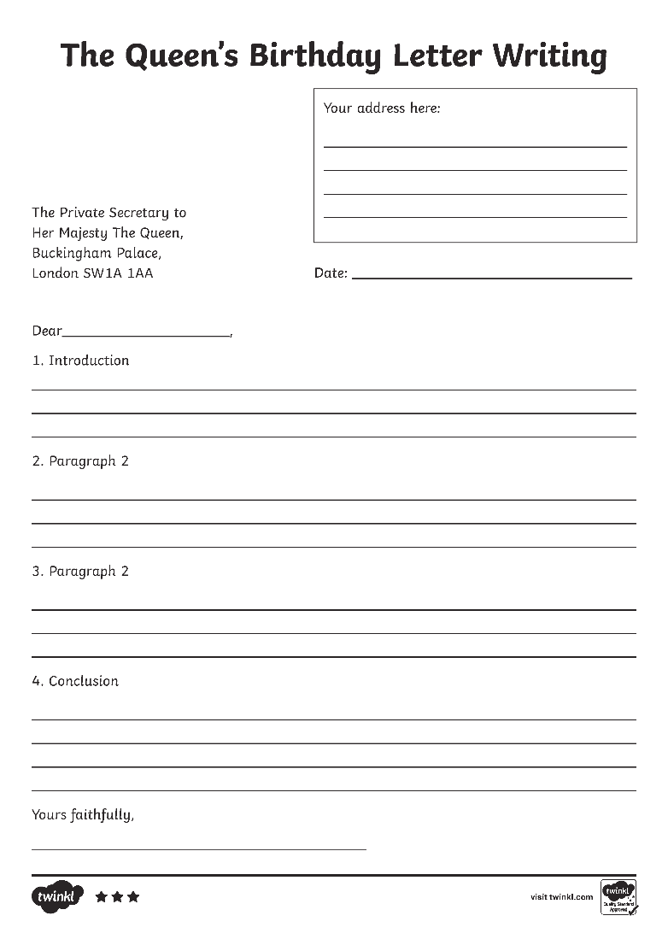
The Format of Your Letter
Use the Writing to The Queen letter writing frames to help you to structure your letter.
Your letter should have:
A clear introduction, where you introduce yourself and why you are writing.
A paragraph that explains how you have or will be celebrating Her Majesty’s birthday.
A paragraph to give your own opinions of The Queen and her work. This is also where you can ask any questions that you might want to ask.
A conclusion paragraph where you reiterate why you are writing, thank the reader and wish The Queen a very Happy Birthday.

Slide 13
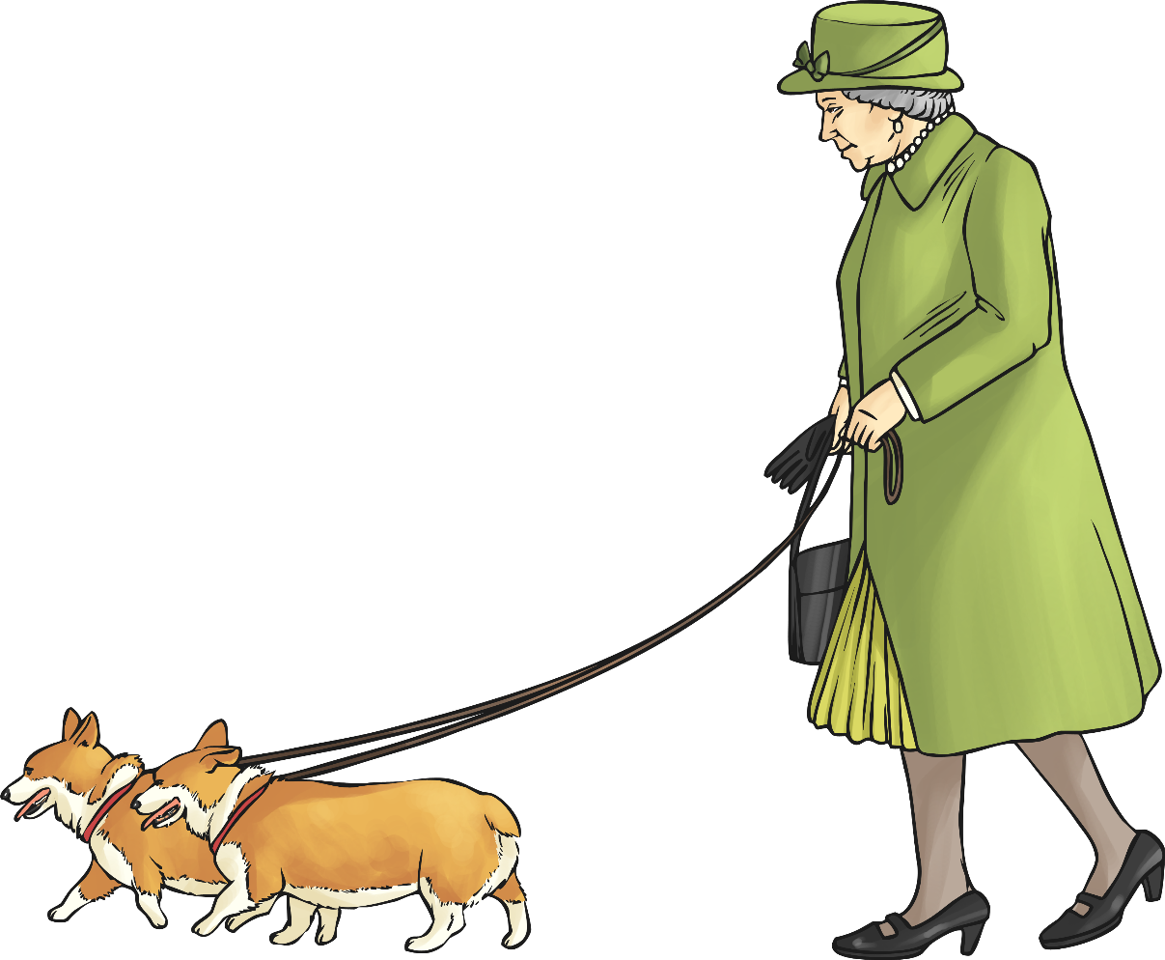
Your Questions for The Queen
What would you like to ask The Queen about in your letter?
Her Majesty’s childhood
Her Majesty’s public commitments
Her Majesty’s family
Her Majesty’s birthday
The Trooping The Colour Parade
Her Majesty’s hopes for the future

